Slide 1



Paklimate
D S A P R O J E C T P R O P O S A L
A look at the importance of technology in improving quality of life
S Y E D A F A R W A R I Z V I - 2 0 0 9 01 0 9 8 T A L H A M O M I N –
2 0 0 9 01 08 9
S Y E D M U H A M M A D AS A D A B B A S N A Q V I – 2 0 0 9 01 0 2 4 A M M A R Z A F A R – 2009 01 087
M A N S O O R K H A N – 200901 078
M U H A M M A D A H S A N A L I - 200901 025

Slide 2
KEY TOPICS DISCUSSED IN THIS PRESENTATION
Introduction to Paklimate Objectives of Paklimate Problem Description Methodology
Project Scope Expertise of Team

Slide 3
Paklimate
Climate change in Pakistan is expected to cause wide-ranging effects on the environment and people in Pakistan.
As a result of ongoing climate change, the climate of Pakistan has become increasingly volatile over the past several decades; this trend is expected to continue.
In addition to increased heat, drought, and extreme weather conditions in some parts of the country, the melting of glaciers in the Himalayas threatens many of the most important rivers of Pakistan.
Between 1999 and 2018, Pakistan was ranked the 5th worst affected country in extreme climate caused by climate change.

Slide 4


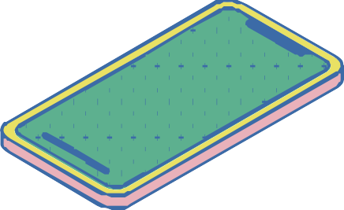

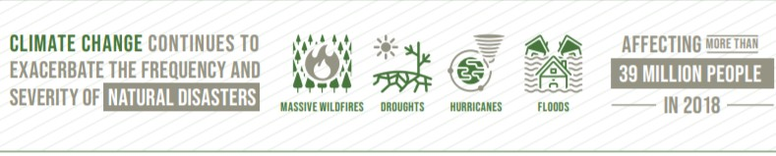
Objectives of Paklimate
This project aims to provide in-depth detail about Climate Change and its effects in Pakistan by being able to let the users retrieve information about cities' status on their environment and edit it accordingly.
Climate Change is one of the Sustainable Development Goals (13) defined by the United Nations to be achieved by 2030 initiated in 2015.
We decided to make a project that provides solutions to real-life problems by first spreading awareness through data statistics.

Slide 5
Problem Description
A T T E M P T I N G T O S O L V E C L I M A T E
C H A N G E
P R O B L E M S U S I N G D A T A S T R U C T U R E S A N D C U S T O M A L G O R I T H M S
Describing in this project that how temperature and pollution, among other factors, affect climate change. For example; Higher temperatures mean that heatwaves are likely to happen more often and last longer.
Warmer temperatures can also lead to a chain reaction of other changes around the world. That's because increasing air temperature also affects the oceans, weather patterns, snow, ice, plants, and animals.
Affected Population 67.7%
Unaffected Population 32.3%

Slide 6
Problem Description
Probable Solutions of individual disasters
Calculate Threats and Sort cities in order from highest to lowest
Add a city and its data (then do 2 accordingly)
1
2
3
4
5
6
Access Data of various cities (temperature and pollution levels)
Update data (change temp and pollution levels, then sort again)
Carbon Footprint Calculator

Slide 7
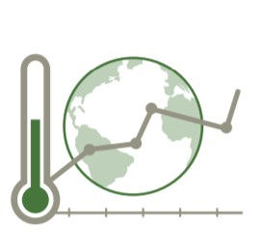
Methodology
H O W I T ' L L W O R K
Using the concepts of Linked lists and altering that concept to fit our goals relative to climate change, we will store data of a few populated cities and compare the cities' statistics.
The user should be able to determine which cities to focus on and in what way, access solutions, access city- wise data comparisons (in the appropriate units and conversions if necessary), and calculate the carbon footprint of their choice.
If the user is authorized personnel, they will alter the data (add cities, update existing city data).
Each city has a set of data that the threat level of Climate Change affects. For example, temperature, pollution levels (air, land, noise, water).

Slide 8

Project Scope
Monitor
Analyze
Aid
Monitoring and recording the city-wise data.
Updating, adding, calculating, and initially storing statistics.
Analysis of data (pollution levels, temperature) to determine the high priority cities.
The key milestone is to make a positive impact by creating awareness amongst the masses regarding climate change and calling for authorities to take swift action immediately.
Gives authorized users the ability to add cities and update climate information, among others.
Ensuring that these concerns are being addressed by showing possible solutions to these problems by taking into account the high-priority cities of Pakistan when it comes to defense against climate change.
Can further be extended into a full-fledged application.

Slide 9

Expertise of the Team
All our team members are pre-equipped with the level of knowledge needed for the successful completion of this project.
Everyone in this group has required knowledge of data structures and has worked using data structures, algorithms, and object-oriented programming in python.

